Slide 1


Slide 2
Chapter 5
IF STATEMENTS
Brief Summary of Chapter 5
Chapter 5 focuses on if statements, a fundamental tool used to control the flow of a program based on conditions. It covers conditional tests, where comparisons between values determine whether specific actions should be executed. The chapter explores different types of if statements such as simple if statements, if-else statements, and if-elif-else chains to handle multiple decision-making scenarios.
The chapter also explains how to use if statements with lists, including checking for special items, empty lists, and validating user input. Additionally, it emphasizes styling practices, such as proper spacing around comparison operators to enhance code readability.

Slide 3
A Simple Example
An if statement allows the program to evaluate an expression, known as a conditional test, which can either be True or False. If the condition is true, the code block inside the if statement will run; otherwise, it will be skipped. The most basic conditional test is checking for equality using the == operator to compare two values and verify if they are equal. On the other hand, checking for inequality uses the != operator to determine if two values are not equal.
The section also covers numerical comparisons, where you can check if a number is less than (<), greater than (>), or equal to (==) another number. Additionally, you can check multiple conditions using and and or. The and operator requires all conditions to be true, while or passes if at least one condition is true. Another important concept is checking whether a value exists in a list using the in keyword, which checks if a value is present in a list, while not in checks if a value is absent. Finally, the section introduces Boolean expressions, which are conditions that could either be True or False, controlling the flow of the program.

Slide 4
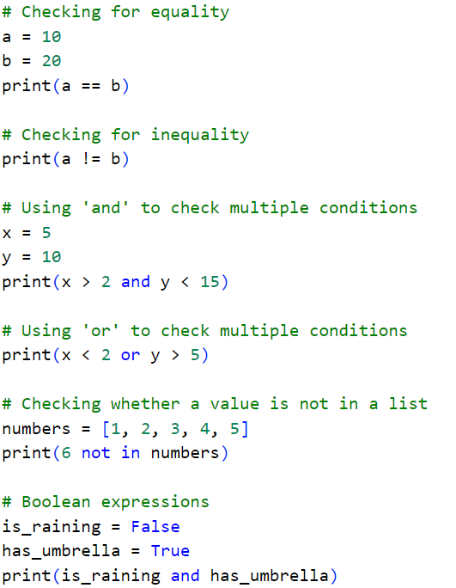
Python Script

Slide 5
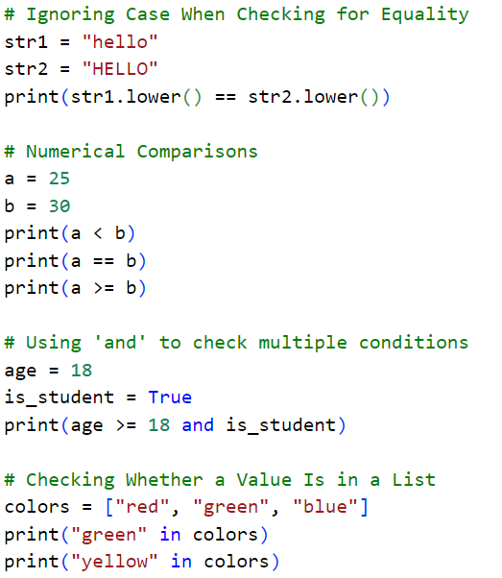
Test in Python Shell

Slide 6
Conditional Statements
In "Conditional Statements," the else and elif statements help control program flow with multiple conditions. The else statement defines a block of code that runs when all previous conditions fail, acting as a fallback. Meanwhile, elif (short for "else if") allows for additional conditions to be checked after an initial if statement, executing the corresponding block of code when its condition is true.

Slide 7
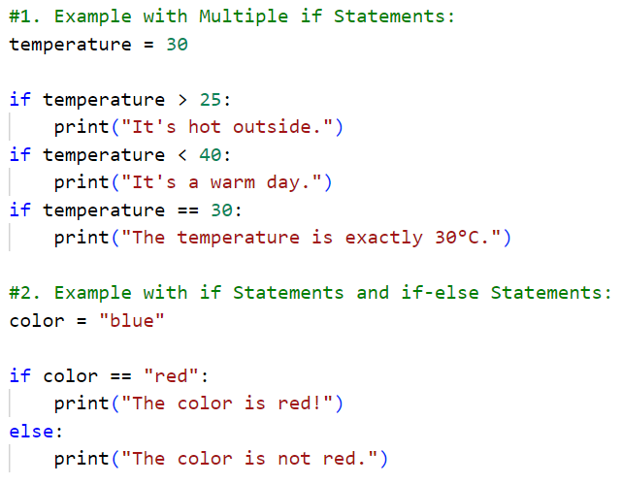

Slide 8
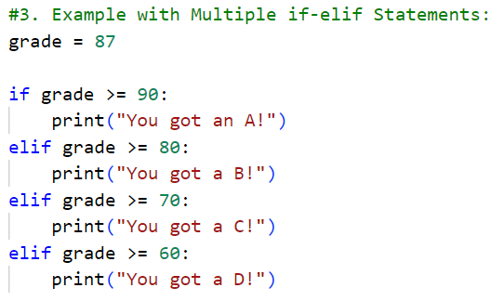

Slide 9
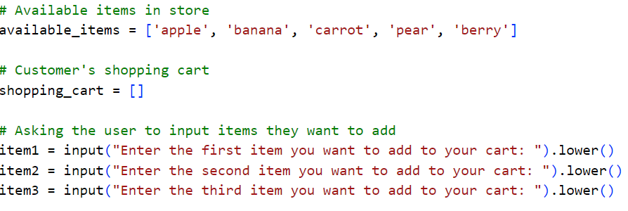
Using if Statements with Lists
How can you use if statements with lists to check for special items (e.g., discounts), handle situations where a shopping cart is empty, and ensure that only available items from a store's inventory are purchased?

Slide 10
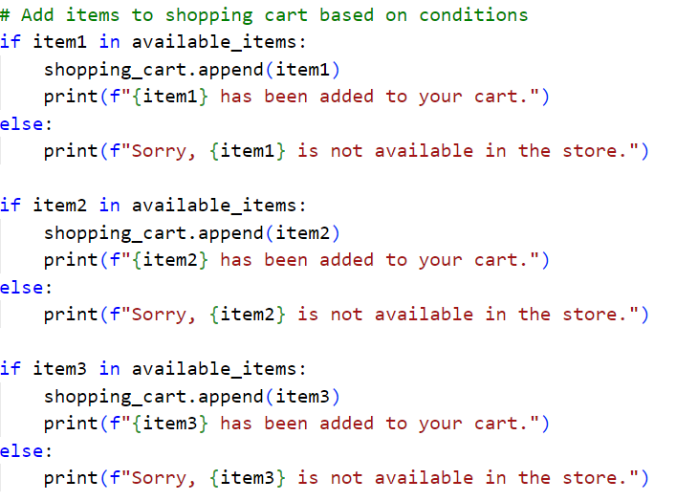

Slide 11
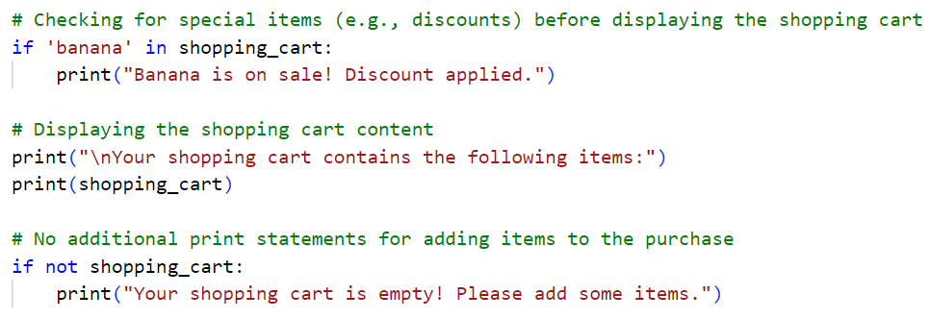

Slide 12
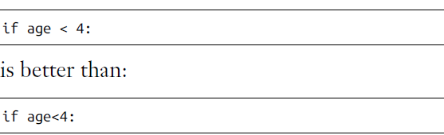
Styling Your if Statements
In every example in this chapter, you’ve seen good styling habits. The only
recommendation PEP 8 provides for styling conditional tests is to use a
single space around comparison operators, such as ==, >=, <=. For example:
Such spacing does not affect the way Python interprets your code; it just
makes your code easier for you and others to read.

Slide 13
Practice Exercises
Do the following TRY IT YOURSELF on pages:
77
84
88
89

Slide 14

End
Of
Chapter 5

